Slide 1
Propulsion Selection

Slide 2
# of engines
2- allows survivability for flare ups/austere field mishaps
MRW (Turbofans (lbs)):
A10= 50000
T4 = 16535
Alpha jet = 16535
Decreases wing weight availability, loads on tail/wings/stabilizer

Slide 3
# of engines-1- Chosen
1- is problematic if flare ups
MRW (Turbofans (lbs))
L39 = 13227
M345 = 9921
Allows access to wings, generally lighter based on data
Thinking of configuring gun on nose, using engine weight to balance the cg towards the back

Slide 4
Turbojet
Inefficient, expensive, not reasonable for this mission
Poor SFC and leads to turbofan discussion
Similarity analysis based:
A1 MRW= 25000 lbs
SU25 MRW = 42549 lbs

Slide 5
Turbojet (J85- best option of jets)
Ramp weight: 11616 lbs
Empty weight: 4133.59 lbs
Fuel weight: 5682 lbs
Speed: 430 knots- A-37 Dragonfly
Thrust/power/engine: 3000 lbs
SFC: .96
Thrust/W: 7.36

Slide 6
Turboprop
Operate well in austere fields
Single-prop: Interferes with nose cannon
Less efficient at higher altitudes
Fly at lower speeds

Slide 7
Turboprop (PT6- best option for single-engine props)
Ramp weight: 13258 lb
Empty weight: 7065 lb
Fuel weight: 4393 lb
Speed: 280 knots (Super Tucano)
Thrust/power/engine: 1566 hp
SFC: 0.54
Power/W: 2.73

Slide 8
Turbofan-Ferry Mission- chosen 1X (Honeywell TFE731)
At AR:6.5, Area = 200 ft^2
Ramp weight: 11744.56545 lbs
Empty weight: 6581.02 lbs
Fuel weight: 3363.544 lbs
Speed: 442 knots, 746 ft/s
Thrust/power/engine: 4125 lbf (average)
SFC: .48
Thrust/W: 5
Engine Types Spreadsheet for more comparisons

Slide 9
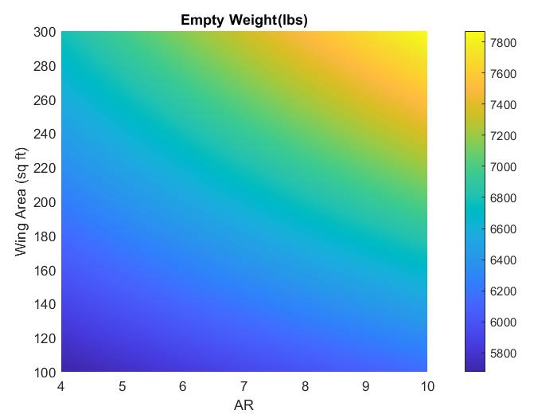
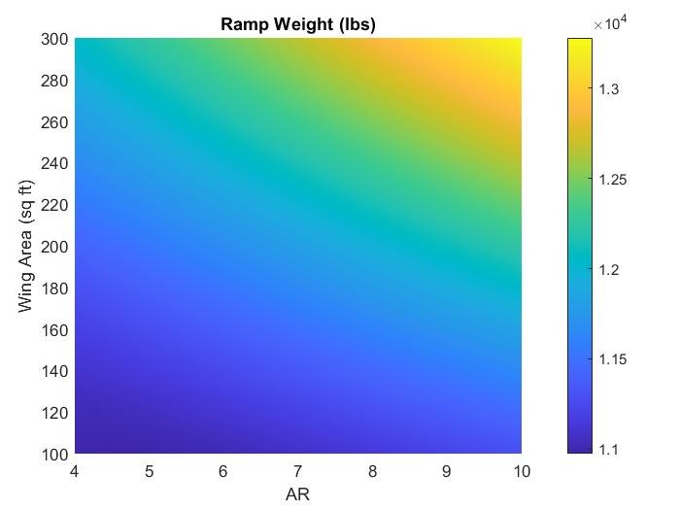
Ferry Mission Plots

Slide 10
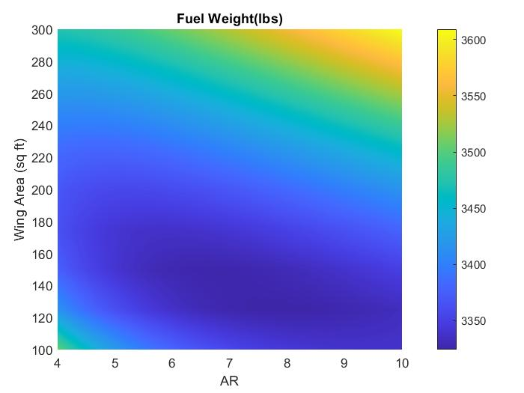
Ferry Mission Plots

Slide 11
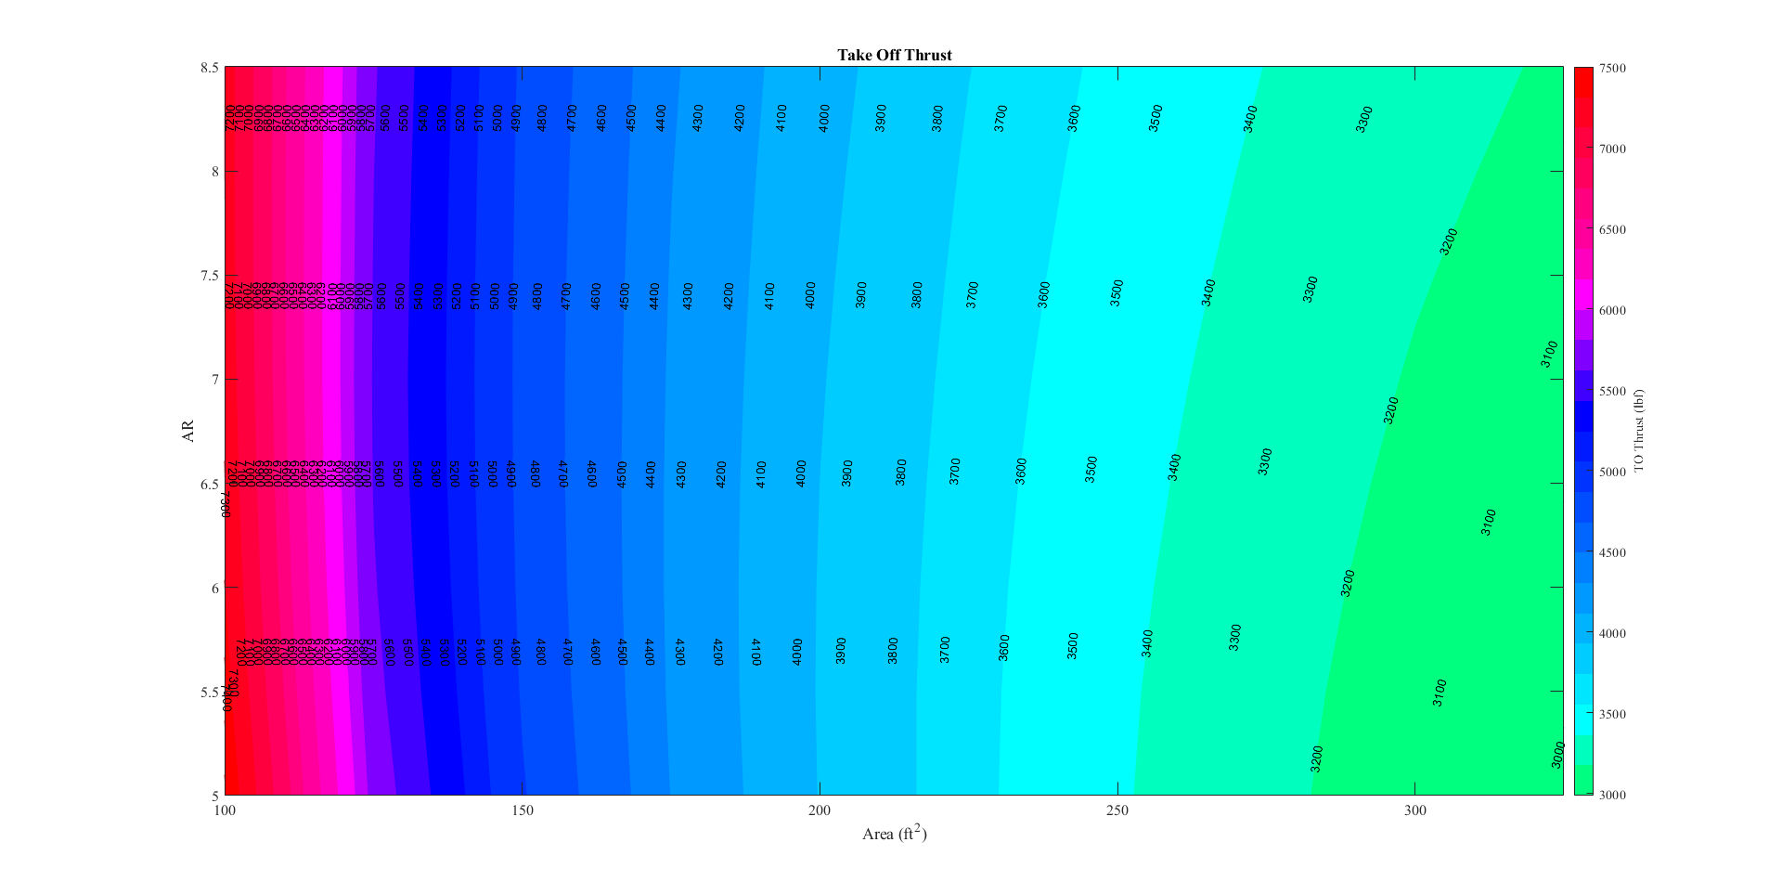
Design Mission Plots

Slide 12
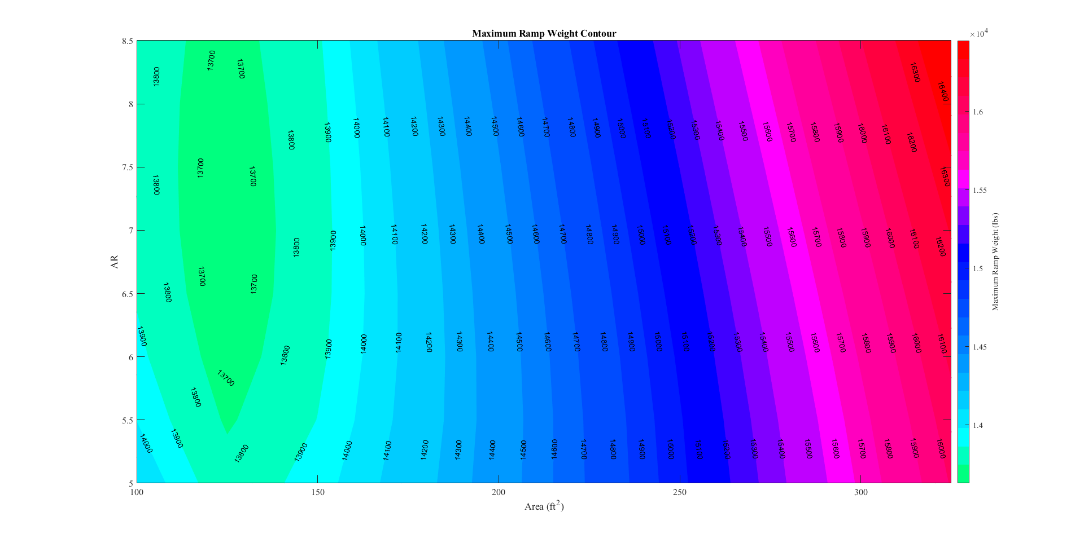
Design Mission Plots

Slide 13
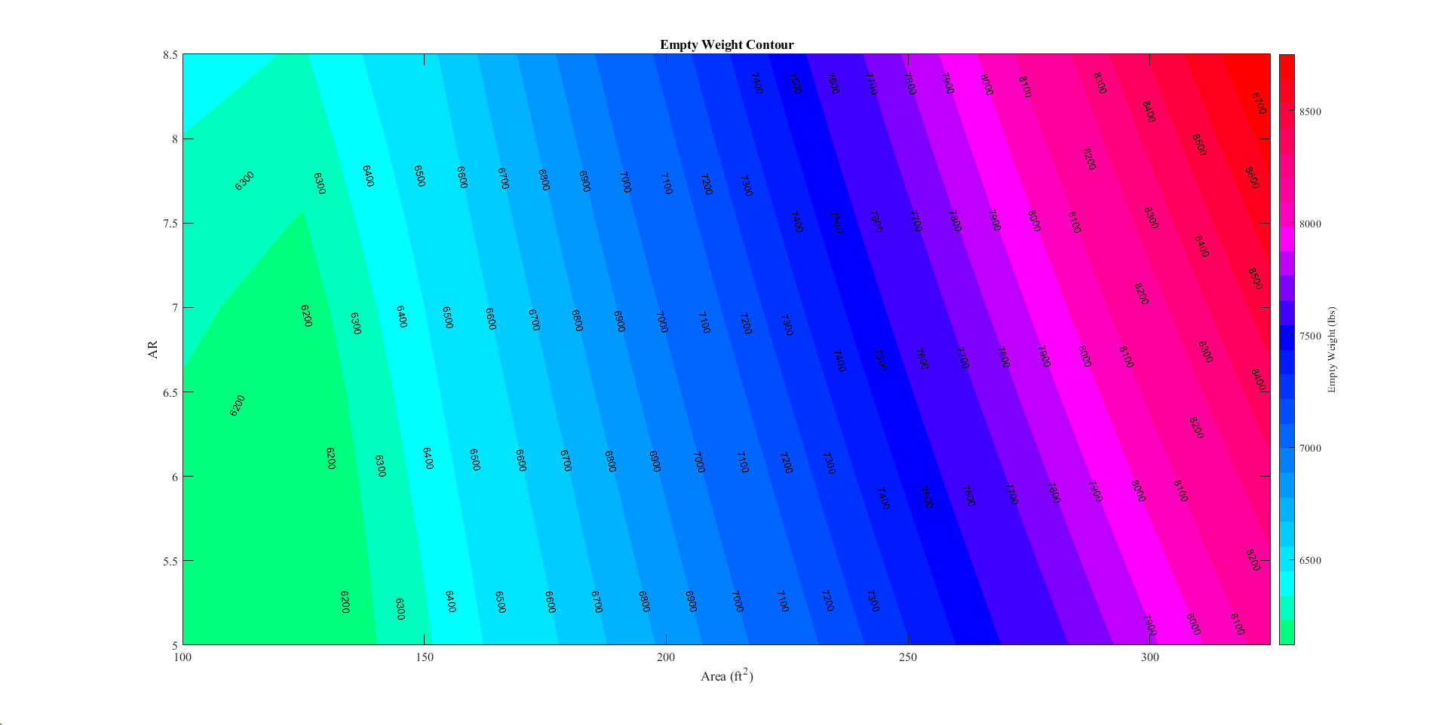
Design Mission Plots

Slide 14
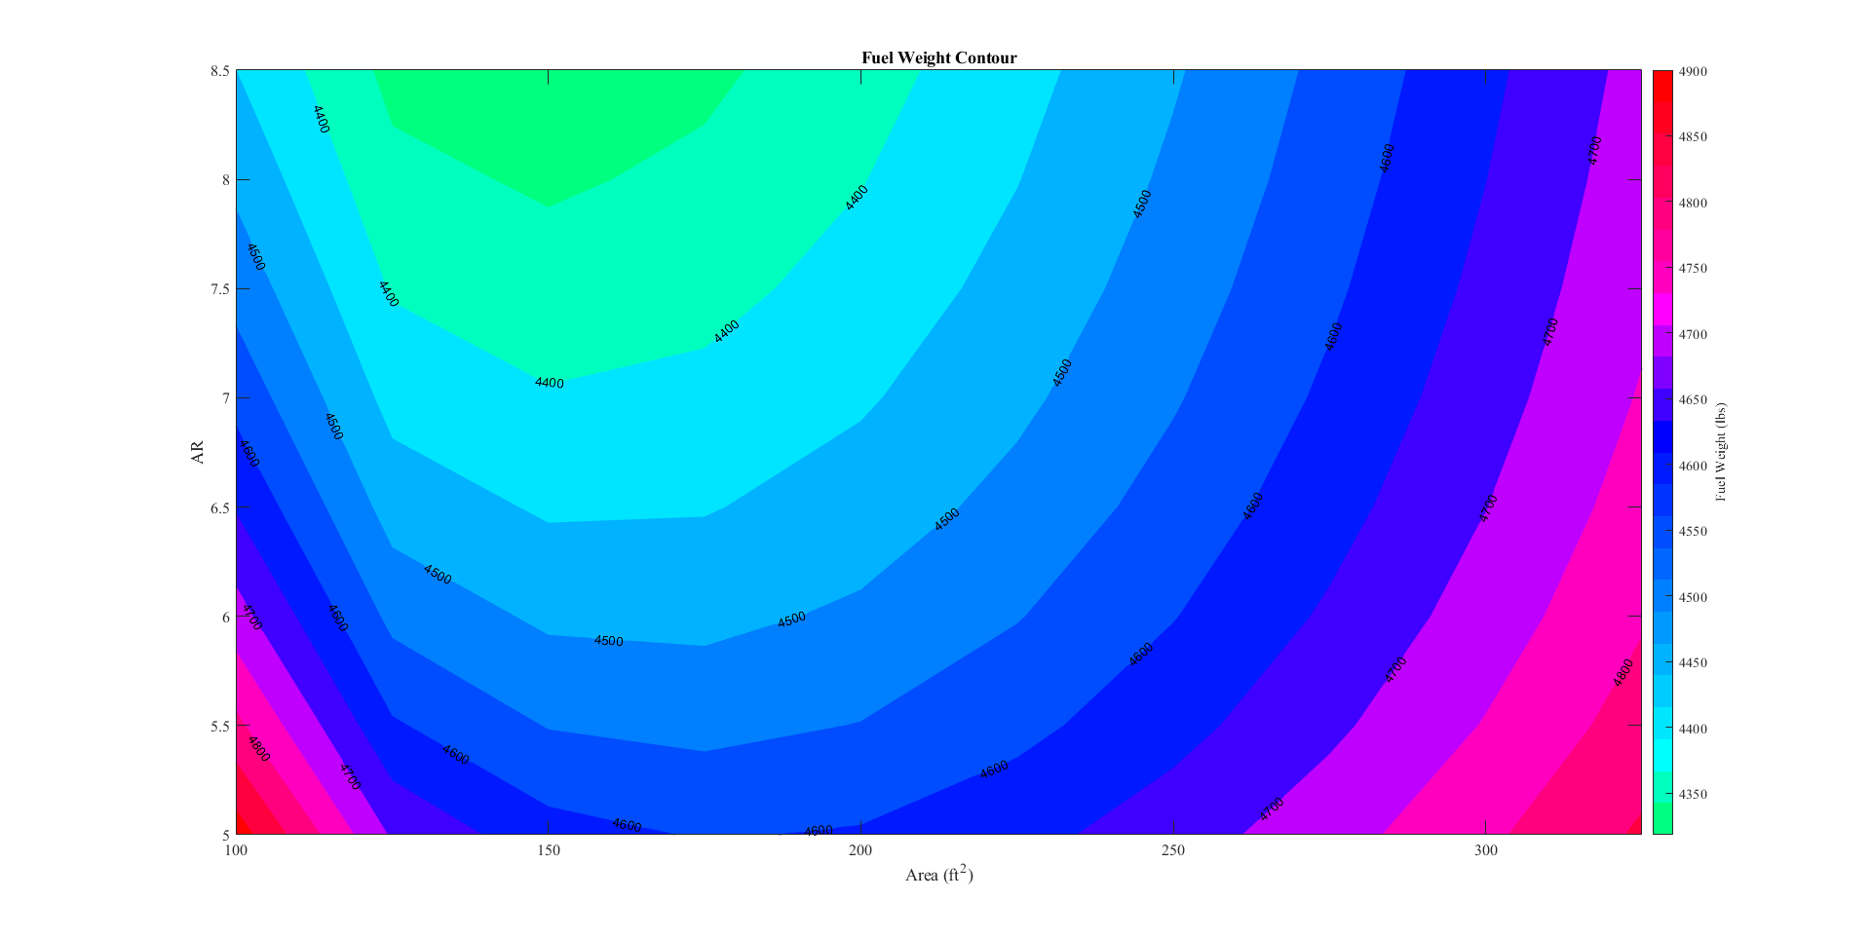
Design Mission Plots

Slide 15
Turbofan
Best SFC and Thrust combination
Allows ROC and performance at high altitudes
Turbofan allows us to place within tail
Balances out CG with weaponry if placed in nose
Frees up space to use on wings
Single Turbofan- twin: too powerful/not necessary (A10)
Unless FJ144/SNECMA Turbomeca Larzac – high ramp weight

